Slide 1
Competitive Learning (Kohonen SOM)
Artificial Intelligence
November 6, 2019

Slide 2
Our Plan
W | 10/23/2019 | Neural Networks | Intro to Neural Networks
M | 10/28/2019 | Machine Learning | Quiz | Quiz 3 (Machine Learning)
W | 10/30/2019 | Neural Networks | Feedforward Networks (Backprop)
M | 11/04/2019 | Neural Networks | Recurrent Networks (Hopfield) | Assignment 3 (Machine Learning)
W | 11/06/2019 | Neural Networks | Self Organizing Maps
M | 11/11/2019 | Deep Learning | Intro to Deep Learning
W | 11/13/2019 | Neural Networks | Quiz | Quiz 4 (Neural Networks)

Slide 3
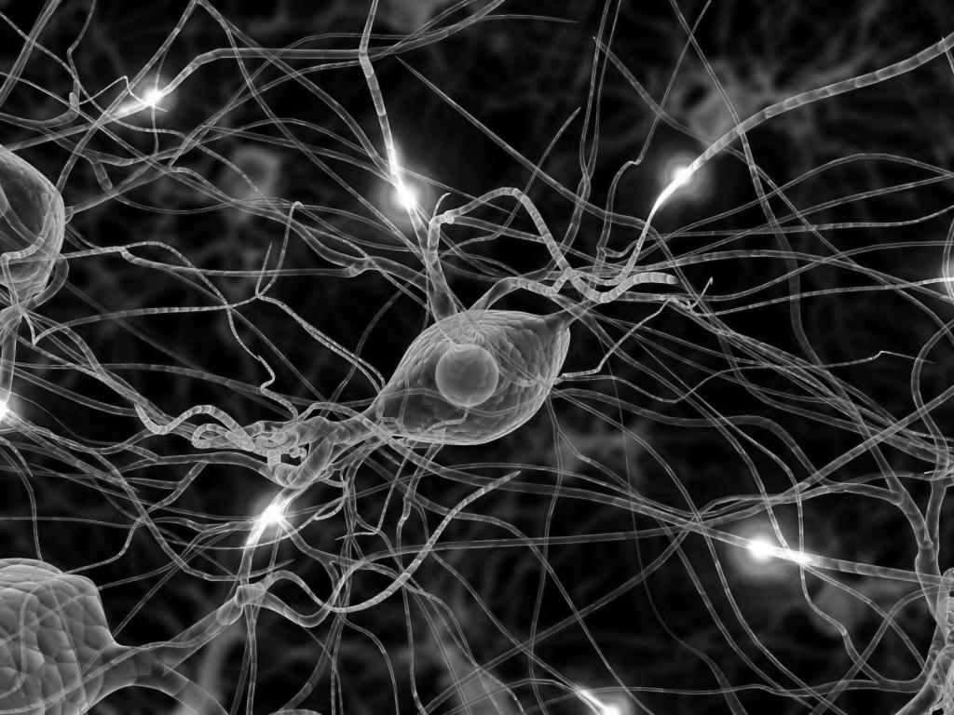
Artificial Neural Networks
Intro to ANNs and the Perceptron
Feedforward Networks (Backprop)
Recurrent Networks (Hopfield)
Competitive Learning (Kohonen Self-organizing map)

Slide 4
Quiz 4 (Wednesday – 11/3)
Topic | Materials
Intro to ANNs and the Perceptron | Yoshimi CH 1&2 & 3 (highlighted sections) and Slides
Recurrent Networks (Hopfield) | Hopfield Handout and Slides (Yoshimi CH6 is Optional)
Feedforward Networks (Backprop) | Backprop Worked Example, Slides, and PerceptronLearn.xlsx (Yoshimi CH 7-9 is optional)
Competitive Learning (Kohonen Self-organizing map) | KohonenSOMWorkedExample and Slides (Yoshimi CH 10 is optional)

Slide 5
Quiz 4: Content
Conceptual knowledge of basic concepts (perceptron, activation function, recurrent network, hidden layers, pattern association, competitive learning, Hebbian learning, etc)
To prepare: Carefully read over the slides and readings and self-explain
Detailed understanding of three major algorithms (Backprop; Hopfield network; Kohonen SOM)
Will be asked to perform operations on simple networks (e.g., given network with inputs compute output and adjust weights; store memories in Hopfield network)
Go through the worked examples and tn-class activities, then complete the take-home practice

Slide 6
Today
Intro to Competitive Learning
Self-Organizing Maps (SOM)
Kohonen SOM
Worke

Slide 7
Competitive Learning

Slide 8
Orienting nodes (green dots) to Input

Slide 9
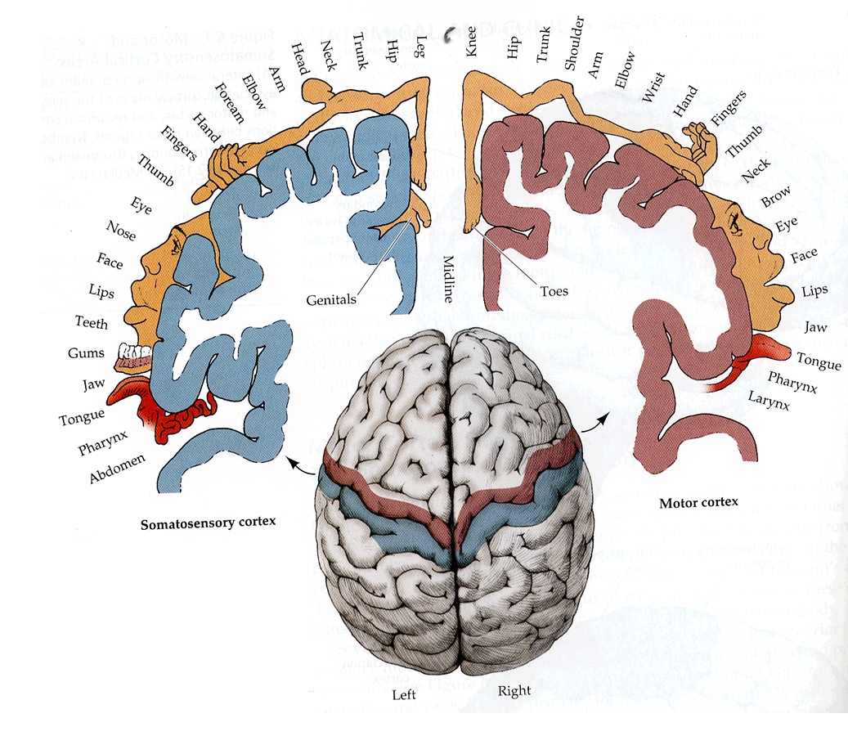
Topographical Map in Brain

Slide 10
Principle of topographic map formulation
“the spatial location of an output neuron in a topographic map corresponds to a particular domain or feature drawn from the input space”

Slide 11
self-organizing map

Slide 12
Mapping

Slide 13
Lattice (map)
Common output-layer structures:
One-dimensional
Two-dimensional

Slide 14
Example 1: Learning a one-dimensional representation of a two-dimensional (triangular) input space (numbers below are iterations of the algorithm)
0
20
100
1000
10000
25000

Slide 15
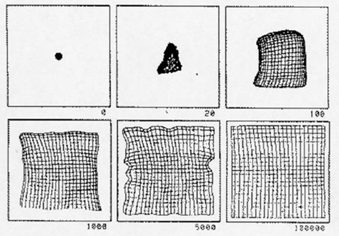
Example 2: Learning a two-dimensional representation of a two-dimensional (square) input space:

Slide 16
Building a SOM
Transform input of arbitrary dimension into a one or two dimensional discrete map while preserving topological properties
Place neurons at the nodes of a one or two dimensional lattice
The neurons become selectively tuned to various stimuli during the course of the competitive learning.
The locations of the neurons so tuned become ordered and a meaningful coordinate system for the input features is created on the lattice

Slide 17
kohonen’s self organizing map (som)

Slide 18
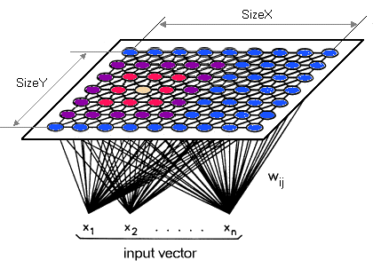
Kohonen SOM

Slide 19
Kohonen SOM (another view)

Slide 20
Neighborhoods
Common output-layer structures:
One-dimensional
i
Two-dimensional
i
Neighborhood of neuron i

Slide 21
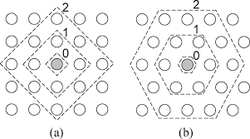
Other Structures & Neighborhoods (Diamond and hexagonal)

Slide 22
Neighborhood Distances
A neighborhood function phi(i, k) indicates how closely neurons i and k in the output layer are connected to each other.
Can be fixed or can vary based on a Gaussian function on the distance between the two neurons :

position of k
position of i

Slide 23
Structure of Kohonen SOM
Consists of a NxN grid (map) of output nodes
Each input node fully connected to all output nodes
Each output node has vector of weights that correspond to input dimension
Output neurons are interconnected within a defined neighborhood
Distance between neighboring neurons fixed or given by neighborhood function
No lateral inhibition among units

Slide 24
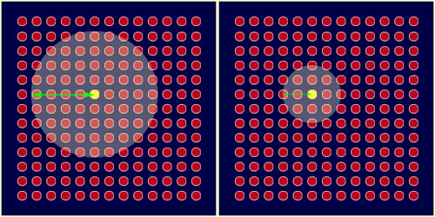
Size of neighborhood shrinks over time – usually geometrically

Slide 25
Learning in SOMs (overview)
Goal is to map output neurons to the input
Start with random connection weights
For each input
Compute distance between input and each output neuron
Pick a winning output neuron (closest to input)
Update winner and its neighbors to move closer to input
Size of neighborhood decreases over time
Learning rate decreases over time as well

Slide 26
Learning Algorithm

Slide 27
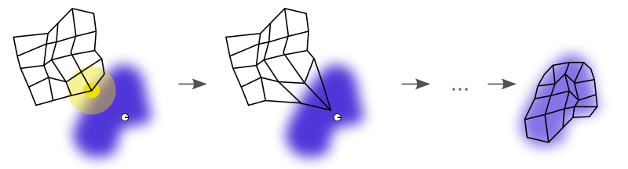
How it works

Slide 30
worked example

Slide 31
Which nodes respond to which inputs after training?

Slide 32
Which nodes respond to which inputs after training?

Slide 33
Which nodes respond to which inputs after training?
Distances among inputs

Slide 34
SOM Examples
http://davis.wpi.edu/~matt/courses/soms/applet.html
http://sund.de/netze/applets/gng/full/GNG-U_0.html
http://www.borgelt.net/somd.html

Slide 35
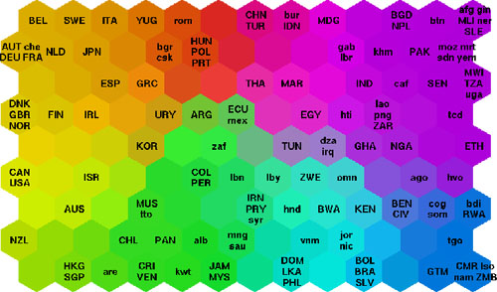
World Poverty Map
input is state of health, nutrition, educational services etc

Slide 36
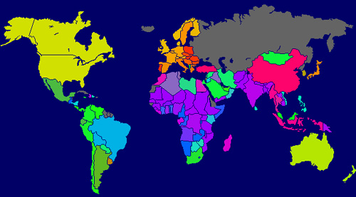
World Poverty Map

Slide 37
in-class activity

